Slide 1


Better outcomes
and lower costs for musculoskeletal care
©2024 Kaiser Foundation Health Plan, Inc.

Slide 2

Better outcomes
and lower costs for musculoskeletal care
©2024 Kaiser Foundation Health Plan, Inc.

Slide 3


What are musculoskeletal conditions?
These disorders affect bones, joints, muscles, connective tissue, and sometimes associated tissues, such as the nerves. They range from minor injuries to long-term conditions with ongoing pain and disability.
There are more than 150 diagnoses of musculoskeletal conditions.¹
Up to 40% of American workers suffer from chronic pain, with roughly half of them receiving inadequate care for it.⁴
These conditions incredibly common, affecting more than half of U.S. adults.²
People with these disorders often have another condition, like hypertension, depression, or diabetes.³
1. United States Bone and Joint Initiative, 2023. 2. See note 1. 3. See note 1. 4. Gulseren et al., Harvard Business Review, July 19, 2021; Briefing Paper, Harvard Business Review Analytic Services, 2022.
Notes:
Musculoskeletal conditions include:
Arthritis
Back, neck, and shoulder pain
Carpal tunnel syndrome
Sprains, strains, and tears
Tendonitis
Musculoskeletal conditions are incredibly common…
More than half of disabilities are due to musculoskeletal disorders.¹
Regarding musculoskeletal disorders and their comorbidities…
It has been estimated that up to 45% of chronic pain sufferers have depression, compared with 5% of the general population.²
______________________________________________________________________
¹United States Bone and Joint Initiative, 2023.
²Gulseren et al., Harvard Business Review, July 19, 2021; Briefing Paper, Harvard Business Review Analytic Services, 2022.

Slide 4

The costs of musculoskeletal conditions are significant
The pain and physical limitations caused by these disorders can negatively impact employees’ well-being, morale, and productivity regardless of their industry or job function, as well as businesses’ bottom lines through direct and indirect costs.¹
75%
of employers rank musculoskeletal conditions as a top 2 health condition driving their costs.²
$8,919
added annual health care costs for each employee with arthritis.³
14
missed workdays per year per employee with at least one of these conditions.⁴
41%
of employees who began working from home in 2020 developed new pain in their shoulders, back, or wrists.⁵
Musculoskeletal conditions account for nearly 15% of employers’ total medical costs.⁶
1. EHSToday.com, August 30, 2022; United States Bone and Joint Initiative, 2023. 2. National Business Group on Health, August 2023. 3. Ortaliza et al., Peterson-KFF Health System Tracker, November 12, 2021. 4. U.S. Bureau of Labor Statistics, 2023. 5. Chubb Survey, 2020. 6. Castlight Workforce Health Index, 2022.
Notes:
Physical limitations include limited mobility, dexterity, and overall functioning.

Slide 5

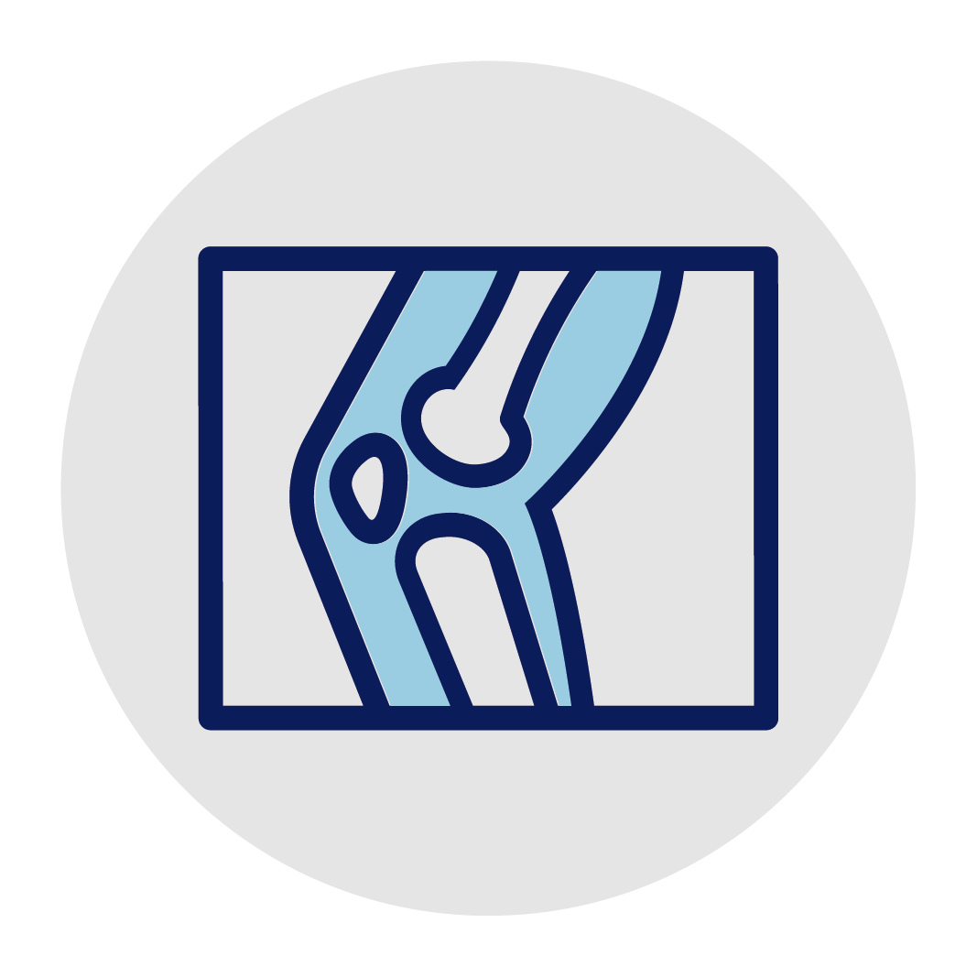



Coordinated, connected care
to manage these common, costly conditions
Primary care
Specialists in orthopedics, rheumatology, pain management, and more
In-person and virtual primary
and specialty care visits
360-degree
musculoskeletal
care
With Kaiser Permanente, your employees will receive personalized, evidence-based care from doctors and specialists who work together in an integrated system to deliver better care and healthier outcomes.
Clinics with multispecialty care
In-person and virtual physical therapy
Notes:
Multidisciplinary teams work seamlessly together
Our care teams deliver high-quality care through collaboration and sharing of best practices and the latest care protocols.
For instance, Kaiser Permanente is in the top 5% nationwide in avoiding unnecessary imaging for low back pain.* Our doctors saw that evidence shows routine imaging (X-ray, MRI, CT scans) for lower back pain does not improve outcomes. Plus, avoiding these tests protects patients from unnecessary radiation exposure and reduces health care costs.
With this coordinated, connected care system, your employees can expect high-quality, evidenced-based care that can help prevent, diagnose, treat, and rehabilitate musculoskeletal conditions.
Employees’ health records updated at every care touchpoint
Our electronic health record system enables our care teams to develop more effective, personalized care plans based on the most up-to-date patient information.
All diagnoses, treatments, and progress reports are captured in your employees’ electronic health records, which provides the data and insights that care teams use to optimize treatment and ongoing care.
_____________________________________________________________________
*Kaiser Permanente 2023 HEDIS® scores. Benchmarks provided by the National Committee for Quality Assurance (NCQA) Quality Compass® and represent all lines of business. Kaiser Permanente combined region scores were provided by the Kaiser Permanente Department of Care and Service Quality. The source for data contained in this publication is Quality Compass 2023 and is used with the permission of NCQA. Quality Compass 2023 includes certain CAHPS data. Any data display, analysis, interpretation, or conclusion based on these data is solely that of the authors, and NCQA specifically disclaims responsibility for any such display, analysis, interpretation, or conclusion. Quality Compass® and HEDIS® are registered trademarks of NCQA. CAHPS® is a registered trademark of the Agency for Healthcare Research and Quality.

Slide 6




Integrated telehealth options for
every stage of the care journey
When in-person care isn’t needed, our virtual care options offer your employees many convenient ways to prevent, diagnose, and treat musculoskeletal problems.
Preventive care tools
Online self-service tools
kp.org and mobile app
24/7 virtual care and advice
Phone and video visits
Live online chat
Email for nonurgent questions
Virtual physical therapy
Remote patient monitoring
Self-care resources
Preventive care
Primary care
Specialty care
Notes:
Truly integrated in-person and virtual care offers your employees convenient ways to get care — and helps catch problems before they become more serious and costly.
One way we help your employees self-manage and prevent more serious conditions is through our virtual care program.
For example, your employees can submit an e-visit for low back pain (in most markets), removing the barrier of having to call, schedule, and connect with a primary physician before being referred to a physical therapist. That way your employees’ concerns are addressed immediately, before they can develop into more serious problems.

Slide 7



On-demand self-care resources put health management and prevention in reach
Increasing physical activity, reducing stress, and keeping a healthy body weight can reduce risk factors for developing a musculoskeletal problem.*
Employees can self-manage or reduce the risk of musculoskeletal conditions with health and wellness resources at no cost to them.
Headspace Care
Online weight management program
On-demand video exercise classes
1-on-1 emotional support coaching by text
*Colorado State University Risk Management & Insurance, accessed November 16, 2023.
The app and services described above are not covered under health plan benefits, are not a Medicare-covered benefit, and are not subject to the terms set forth in members’ Evidence of Coverage or other plan documents. The app and services may be discontinued at any time. The Headspace Care app and services are not available to any members under 18 years old. Eligible Kaiser Permanente members can text with a coach using the Headspace Care app for 90 days per year. After the 90 days, members can continue to access the other services available on the Headspace Care app for the remainder of the year at no cost.
Notes:
ClassPass workouts include yoga, dance, cardio, boxing, Pilates, bootcamp, and more.
Headspace Care coaching is available 24/7 and offers personalized self-care resources.
We offer other on-demand self-care resources on kp.org to help members reach their health goals, such as the Total Health Assessment.
Based on their Total Health Assessments’ results, our members will find advice, encouragement, and tools to help them make healthier lifestyle choices that can help reduce their risk factors for developing a musculoskeletal problem, including:
Eating healthy
Losing weight
Moving more
Sleeping better
Reducing stress
Quitting smoking

Slide 8

Improving access, adherence, and outcomes: Virtual physical therapy
At Kaiser Permanente, physical therapy (PT) is prescribed before costlier, more invasive interventions are considered. For conditions that don’t require an in-person visit, your employees can get care at home through our virtual PT program — at no extra charge.
15%
62%
Virtual PT users had 63% lower costs compared with traditional PT, and fewer hospital readmissions after total knee arthroplasty.*
Patients who participated in our virtual patient education and home exercise pilot program prior to surgery experienced:
better outcomes
fewer home health visits
*Bettger et al., The Journal of Bone and Joint Surgery, January 15, 2020.
Notes:
Our virtual PT is included your employees’ health plan at no extra charge. And it’s connected to their overall Kaiser Permanente health care experience through their electronic health record.
The many values of virtual PT include:
Just as effective as in-person PT
Personalized regimens and real-time feedback
No need to commute or take time off work
Adherence improved
Lower risk of unnecessary visits and procedures minimized*
___________________________________________________________________
*Cottrell et. al., Musculoskeletal Science & Practice, August 2020; National Business Group on Health, April 1, 2019.

Slide 9

Excellence in evidence-based care:
ACL reconstruction
By studying data from all our anterior cruciate ligament (ACL) reconstructions, we found that outcomes were better with autografts (the use of a patient’s own body tissue) instead of with allografts (the use of donor tissue).
Our surgeons began using autografts whenever possible, with great results:¹
3 in 4
Kaiser Permanente ACL reconstruction patients now get autografts.
From 2009 to 2020, our ACL-repair patients experienced a:
Only 2.4%
of our patients need follow-up ACL surgery within 2 years, compared with an average of 3.1% outside Kaiser Permanente.²
We’ve prevented more than 1,200 follow-up surgeries and saved over $21 million, helping drive cost efficiency across our organization.
77%
decline in hospital readmissions
20%
decline in emergency room visits
1. Kaiser Permanente internal data. 2-year revision rate tracked from 2005–2018. Readmissions and emergency visits tracked from 2009–2020.
2. Average outside Kaiser Permanente: Liukkonenn et al., The Orthopaedic Journal of Sports Medicine, August 2022.
Notes:
We’re committed to excellence in evidence-based care. One way we achieve high-quality care is by creating registries that track more than 4 million member implants, devices, and surgeries.
These registries enable us to:
Monitor patient health outcomes
Determine the most effective surgical techniques and devices
Efficiently address device recalls
For example, we created a registry to track the outcomes of members who received anterior cruciate ligament (ACL) reconstruction:
The data showed that members who got grafts using tissue from their own body (or autografts) needed fewer follow-up surgeries than those who got grafts using donor tissue (or allografts).
With this knowledge, we encouraged our surgeons to use autografts when possible.

Slide 10
Excellence in evidence-based care:
Joint-replacement surgeries
Kaiser Permanente is outperforming the market in reducing hospital readmission rates for members getting shoulder, knee, and hip replacement surgeries.
Hospital readmission rates
Shoulder (30-day)
Knee (90-day)
Hip (90-day)
8.1%
7.6%
4.4%
4.8%
5.9%
2.2%
Kaiser Permanente¹
Market average²
Kaiser Permanente³
Market average⁴
Kaiser Permanente⁵
Market average⁶
Why it matters: Based on the U.S. average cost, each readmission your employee avoids can save your business approximately $16,300.⁷
1. Kaiser Permanente 30-day readmission rates, 2009–2021. 2. Mahoney et al., Journal of Shoulder and Elbow Surgery, 2014. 3. Kaiser Permanente 90-day readmission rates, 2009–2021. 4. Fry et al., The Journal of Bone and Joint Surgery, 2017. 5. See note 3. 6. See note 4. 7. Agency for Healthcare Research and Quality, September 2023.
Notes:
Again, in these instances, we achieve better health outcomes and patient experience through our commitment to evidence-based medicine and the use of our registries to improve our approach to joint-replacement surgeries.

Slide 11



Improving care experience and outcomes: Same-day, joint-replacement program
In many cases, patients can receive same-day procedures — including elective total hip and knee joint replacement — so that they can recover safely and comfortably at home.
From 2016 through 2020
Members undergoing same-day elective total hip or knee joint replacement versus surgeries with overnight hospital stays increased from 7% to about 80%.
Our patients with same-day procedures experienced:³
  27,000+ fewer overnight stays
  Fewer readmissions and emergency visits
  Higher satisfaction with overall care
Kaiser Permanente¹
National average²
80%
51%
Why it matters: The cost of a hospital admission in the U.S. averages $14,500.⁴ When appropriate, same-day procedures can help your employees and your business avoid the cost of unnecessary inpatient stays.
1. Koplan et al., NEJM Catalyst, February 2021. 2. OrthoInfo, October, 27, 2023. 3. Kaiser Permanente internal data, Northern California.
4. Agency for Healthcare Research and Quality, September 2023.
Notes:
Members getting joint replacements at Kaiser Permanente also are more likely to be discharged the same day and safely recover at home, reducing their risk of infection.*
Before and after surgery, your employees will get personal attention, support, and guidance from our nurse navigators who’ll:
Provide patient education resources
Coordinate care services
Monitor rehabilitation and recovery plans
Address post-operative concerns
_______________________________________________________________________
*Kaiser Permanente internal data, Northern California.

Slide 12
Prioritizing safety and recovery outcomes
At Kaiser Permanente, your employees are in excellent hands. Postoperative infections can lead to longer hospital stays, costly follow-up surgery and treatment, and time away from work.¹ But by standardizing best practices throughout our facilities, including infection prevention protocols, we’ve established consistently low infection rates among those who receive surgery for musculoskeletal conditions.
Postoperative infection rates
ACLR (90-day)
Knee (90-day)
Hip (90-day)
Spine (1-year)
Shoulder (1-year)
2.4%
(RTSA)
1.66%
1.8%
(TSA)
0.86%
0.59%
0.23%
0.74%
0.34%
0.69%
0.43%
0%
Kaiser Permanente²
Market average⁴
Kaiser Permanente²
Market average⁵
Kaiser Permanente²
Market average⁶
Kaiser Permanente³
Market average⁷
Kaiser Permanente³
Market
average⁸
1. Fehring et al., The Journal of Bone and Joint Surgery, July 15, 2020. 2. Kaiser Permanente internal data, 2020. 3. Kaiser Permanente internal data, 2019. 4. Zhang et al., Orthopaedic Journal of Sports Medicine, October 13, 2023. 5. Kurtz et al., The Journal of Arthroplasty, October 2018. 6. See note 4. 7. Stewart et al., Surgical Infections, August 2023. 8. Givens et al., Journal of Shoulder and Elbow Surgery, February 2024.
Notes:
Slide notes:
Kaiser Permanente conducts surveillance on surgeries for musculoskeletal conditions and post-operative outcomes via medical device registries. These registries are used to enhance quality of care and improve member safety, including reducing the risk of post-operative infections.
ACLR (anterior cruciate ligament reconstruction)
TSA (total shoulder arthroplasty), RTSA (reverse total shoulder arthroplasty)
Slide sources:
Thomas K. Fehring et al., “What’s New in Musculoskeletal Infection,” The Journal of Bone and Joint Surgery, July 15, 2020. https://www.ncbi.nlm.nih.gov/pmc/articles/PMC7431136/
Kaiser Permanente internal data, 2020.
Kaiser Permanente internal data, 2019.
Lei Zhang et al., “A Systematic Review and Meta-analysis of Risk Factors for an Infection After Anterior Cruciate Ligament Reconstruction,” Orthopaedic Journal of Sports Medicine, October 13, 2023. https://pubmed.ncbi.nlm.nih.gov/37846316/
Steven M. Kurtz et al., “Are We Winning or Losing the Battle With Periprosthetic Joint Infection: Trends in Periprosthetic Joint Infection and Mortality Risk for the Medicare Population,” The Journal of Arthroplasty, October 2018. https://pubmed.ncbi.nlm.nih.gov/29914821/
See note 4.
Kenneth E. Stewart et al., “Trends and Prediction of Surgical Site Infection After Elective Spine Surgery: An Analysis of the American College of Surgeons National Surgical Quality Improvement Project Database,” Surgical Infections, August 2023. https://pubmed.ncbi.nlm.nih.gov/37311216/
Justin M. Givens et al., “Complication rates following reverse and anatomic shoulder replacement in treatment of glenohumeral arthritis: a 10-year Medicare review study,” Journal of Shoulder and Elbow Surgery, February 2024. https://pubmed.ncbi.nlm.nih.gov/37473905/

